Slide 1
Unit 1: Microbial Growth And Effect of Environment On Microbial Growth
Definition of Growth and Measurement of Microbial Growth
Sweta Sushmita Tigga
Lecture – B.Sc Microbiology Sem III
Department of Microbiology,
DSPMU, Ranchi

Slide 4
Microbial Growth
The term growth as commonly applied to bacteria and other microorganisms usually refers to an increase in the number of cells in a population or changes in the total population, not to an increase in the size of the individual cells. Cells division leads to the growth of cell in population.
Growth Increase in number beyond that present in the originial inoculum
Denote

Slide 5
Measurement of Microbial Growth
Measurement of Cell Number
Measurement of Cell Mass

Slide 6
Measurement of Cell Number
By using-
Petroff-Hausser Counting Chamber (Direct Microscope count)
Coulter Counter(Electronic enumeration of cell numbers)
Plating techniques
Membrane Filters

Slide 7
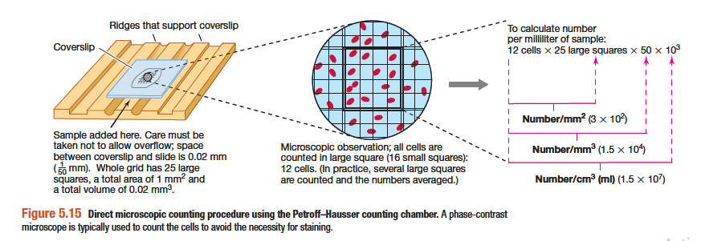
Measurement of Cell Number: Direct Microscope Count by using Petroff- Hauser Counting chamber

Slide 8
Measurement of Cell Number: Direct Microscope Count by using Petroff- Hauser Counting chamber
25 squares covering an area of mm², the total number of bacteria in 1mm²
of the chamber is (number/square)(25 squares). The chamber is 0.02 mm deep and therefore,
Bacteria/mm³ = (bacteria/square) (25 squares)(50)
The number of bacteria per cm3 is 10³ times this value. For example, suppose the average count per square is 28 bacteria :
Bacteria/cm³ = (28 bacteria) (25 square)(50)(10³) = 3.5 X 10 7

Slide 9
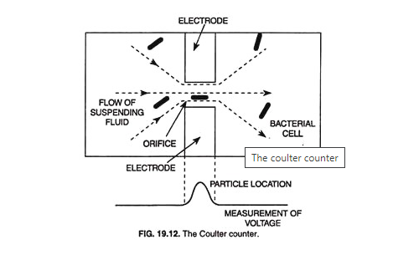
Measurement of Cell Number: Direct Count by using Coulter counter

Slide 10
This device is provided with a tiny orifice 10-30 µm in diameter. This orifice connects the two compartments of the counter which contain an electrically conductive solution (electrodes).
In this method, the sample of bacterial cells is forced through the small orifice (small hole). On the both sides of the orifice, electrodes are present to measure the electric resistance or conductivity when electric current is passed through the orifice.
Every time a bacterial cell passes through the orifice, electrical resistance between the two compartments (electrodes) increases momentarily or the conductivity drops. The generates an electrical signal which is automatically counted.
Each electrical signal represents the counting of one bacterial cell. The Coulter counter gives accurate results with larger cells. The precaution to be taken in this method is that the suspension of samples should be free of any cell debris or other extraneous matter.

Slide 11
Measurement of Cell Number: Plating technique

Slide 12
Measurement of Cell Number: Plating technique

Slide 13
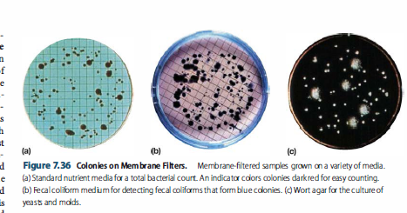
Measurement of Cell Number: Plating technique

Slide 14
Measurement of Cell Mass: Turbidimetric method

Slide 15
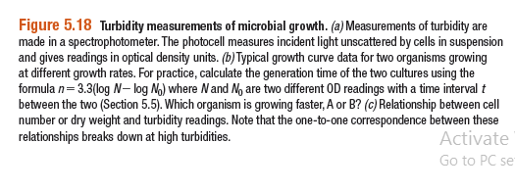
Measurement of Cell Mass: Turbidimetric method

Slide 16
Thank you

